Slide 1

BACD RC Workshop 27 Nov 2013:
“Improvement Action Plans & possible actions in RC”
Alain BERTHET Maria J. ALMENAR MARTIN
Regulation Manager Regional SHE&Q Manager F&BNL

Slide 2
Agenda
Responsible Care and Improvement Action Plans
TPV: SQAS Distributor/ESAD
How to build an IAP
Example of an area to improve→
Product Stewardship (PS)
PS: What needs to be done?

Slide 3
RC & Improvement Action Plan
BACD “Practical requirements”
  Management commitment to the “8 guiding principles”
  RC coordinator appointment
  Performance reporting (KPI)
  Audit Implementation – TPV – to verify RC program implementation & Company performances in terms of EH&S
  Improvement program RC = “continuous improvement”

Slide 4
RC & Improvement Action Plan (IAP)
Audit implementation <-> Improvement Plan
  Following the Audit -> identification of gaps (majors, minors) that should be addressed
  Purpose of an IAP = to address and correct these gaps that may be affecting the business,
  Auditing system – RC: BACD recommends a Third Party Verification (TPV) audit using SQAS Distributor/ESAD
  Where ESAD is not practical (SMEs) BACD developed its own “self assessment tool”
    BACD / FECC discussion on going

Slide 5
TPV: SQAS Distributor / ESAD (www.sqas.org)
  Jointly developed in 2004 by Cefic & Fecc = Questionnaire completely reviewed in 2011!
  A core questionnaire relevant for any LSP + 5 Modules questionnaires relevant to specific activities of companies
  Chemical distributors: SQAS distributor/ESAD Di module (Distributor Standard activities) Di+S; Di+Cs; Di+F; Di+F+G
  Di: Structured around the 8 principles of Responsible Care
  (Requiring the presence of assessors accredited by CEFIC)

Slide 6
TPV: SQAS Distributor / ESAD (www.sqas.org)
SQAS Assessment – getting started:
  Selection of an assessor form the list of accredited SQAS Assessor,
  Fill in the “PAD” (Pre-Assessment Document – Excel): To define the scope of the assessment; provide relevant info about the Cie; Calculate the assessment time…
  -> the assessor carries out the assessment…
  The assessment report is “used by Cies for Risk Management in support of their product Stewardship activities”; Identifies the gap that need to be addressed…-> RC

Slide 7
How to build an IAP
Step 1: Clearly state the problem or weakness, including the root cause.
Step 2: List the individuals who will be accountable for the results of the corrective action, i.e. every action should have an assigned responsible person.
Step 3: Create simple, measurable solutions that address the root cause
Step 4: Set achievable deadlines
Step 5: Monitor the progress of your plan.

Slide 8
How should my IAP look like?

Slide 9



Responsible Care®:
Example of an area to be improved
“Product Stewardship”

Slide 10
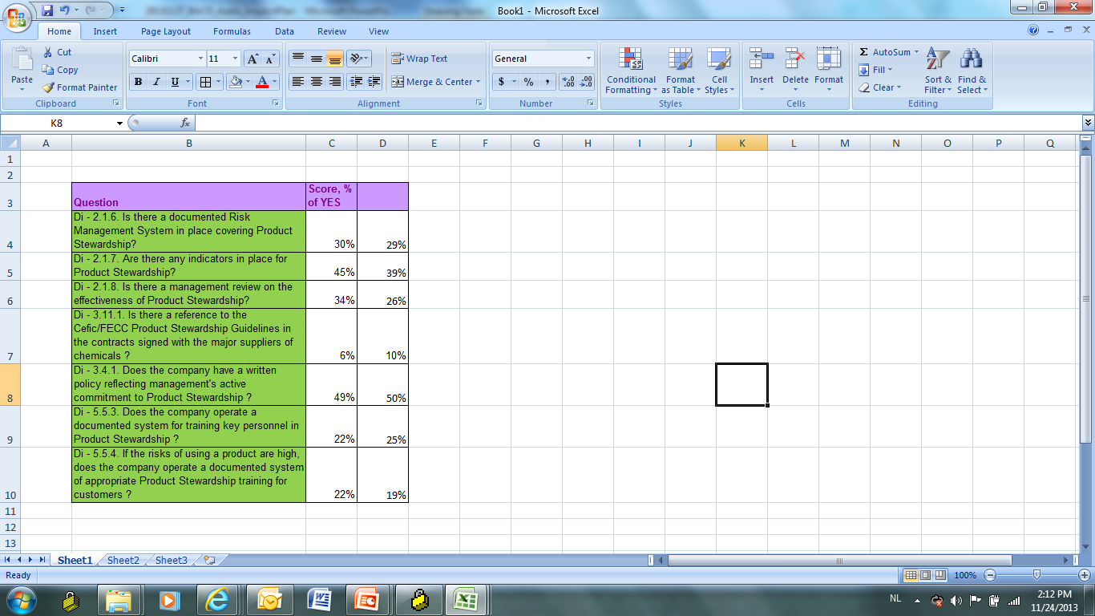
Product Stewardship Scores (2011 – 2012)

Slide 11
PRODUCT STEWARDSHIP IS ATTITUDE-DEPENDENT
Change from reactive
to proactive :
  Chemical distributors and producers care about the HSE
  process of its products all along their life-cycle
  Commits to continuous improvement
  Listens to stakeholders

Slide 12
What needs to be done?
Understand where you are in the life cycle of your product(s)
Understand any inherent risks - current and potential
Recognise the impacts from legislation
Understand the drivers
Understand the impacts to your business
Understand and Recognise!

Slide 13
What needs to be done?
An effective Product Stewardship program contains the four basic components of :
  Management Leadership
  Risk Management (includes compliance)
  Communication
  Cooperation
Management
Leadership
Risk
Management
Communication
Cooperation

Slide 14

Management Leadership
Establish & communicate a Product Stewardship Policy
demonstrating management commitment
Set realistic & attainable goals for the continuous
improvement of performance in relation to Product
Stewardship, provide resources (plan) and measure actual
performance against these.
Champion & develop Product Stewardship across the whole
company. Demonstrate the commitment.
Ensure that Product Stewardship
systems are maintained and
regularly reviewed in a manner
consistent with these principles.
Management
Leadership
Risk
Management
Communication
Cooperation

Slide 15
Risk Management
Evaluate risks resulting from the intended uses of products and periodically update the evaluation
Establish and maintain awareness of HSE hazards and reasonably foreseeable exposures from new and existing products
Control and minimize exposure
Whenever technically and economically feasible:
develop continuously improve processes for minimizing waste, reducing emissions and for the re-use, recovery and disposal of products
Risk
Management
Management
Leadership
Communication
Cooperation

Slide 16
Communication
Provide information to customers, distributors, stakeholders, contractors, logistics providers, poison centers, etc. on safe storage, handling, use & disposal of products
Request information on safe storage, handling, use & disposal of raw material & products obtained from suppliers.
Exchange information to help suppliers meet applicable HSE standards including, wherever possible, feedback on use & possible misuse
Proactively consider public and community concerns on the foreseeable risks & potential adverse effects of products
Management
Leadership
Risk
Management
Cooperation
Communication

Slide 17
Supply Chain Cooperation
Select and work with contractors to continually improve HSE standards
Work with customers, resellers and other downstream users to foster safe storage, handling and disposal of products
Provide training on specific products where needed
Actively seek customer feedback on customer use and misuse of products. Learn from their experience and revise product design, information and advice as appropriate
Management
Leadership
Risk
Management
Communication
Cooperation

Slide 18
Supply Chain Cooperation
Communication up & down the supply chain on safety concerns and related advice
Producers
Distributors
Management
Leadership
Risk
Management
Downstream users
Communication
Communication
Cooperation

Slide 19
PS: Getting started!
Secure commitment of senior management
Nominate Product Steward, set clear goals and well defined responsibilities; provide resources
Collect information on products, markets and their use
Establish product related working groups integrated into existing business teams/Units
Assess business risks and opportunities: select products where early progress can be demonstrated
Set up a management review process
Extend best practice e.g. Responsible Care®
Review performance
Stay alert on potential issues from customers/suppliers
PS is a job for everyone, not only for Q&HSE!

Slide 20
Distributor Expectations
Where appropriate, establish that customers can receive, handle, use and dispose of products safely with minimum risk to stakeholders
Where possible, feedback to Supplier information on new uses or misuses, new potential risks and regulatory developments in territory
Review conditions of further supply, if necessary

Slide 21
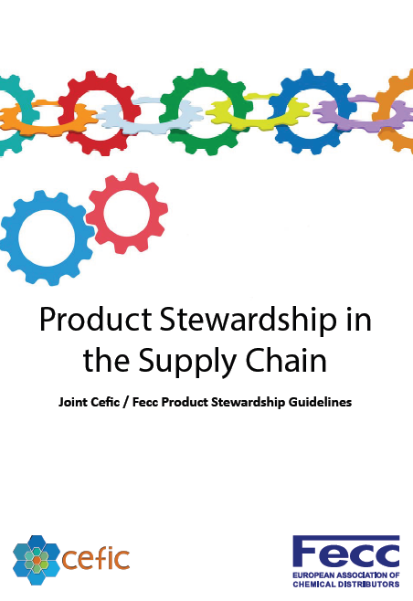
For more info: Cefic-Fecc PS guidelines
http://www.fecc.org/fecc/committees/product-stewardship

Slide 22

Questions

Slide 23
Thank you! Dank U!
Merci! (Gracias!/Mercès)

Slide 24
PRODUCT LIFE
CYCLE
Raw Materials
extraction
Waste
Emissions
Energy
  Production of:
Raw materials, chemicals
Components, etc
Landfill &
Incineration
Waste
Emissions
Energy
Design
Re-Use &
Recycling
Production
Emissions
Energy
Waste
Emissions
Energy
Re-use
Use Phase
Packaging &
Transportation
Waste
Emissions
Energy
Energy
Waste
Emissions
Notes:
A typical lifecycle for many products – Product Stewardship interfaces with all aspects relating to the product

Slide 25






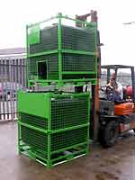


Complex Supply Chain, everybody is responsible!
STORAGE
MANUFACTURE
FORMULATION
PROFESSIONAL/
INDUSTRIAL USER
RE-PACKAGING
DISTRIBUTION
CONSUMER
TRANSPORT

